Slide 1

DOCTOR FINDER
Mohammad Rakibul Hasan - 18.02.04.102
Nazifa Anjum -18.02.04.103
Kanzud Saiyara - 18.02.04.105
Md Zahin Mubashshir - 15.01.04.131
Jubayer Bin Jaman - 17.01.04.125

Slide 2
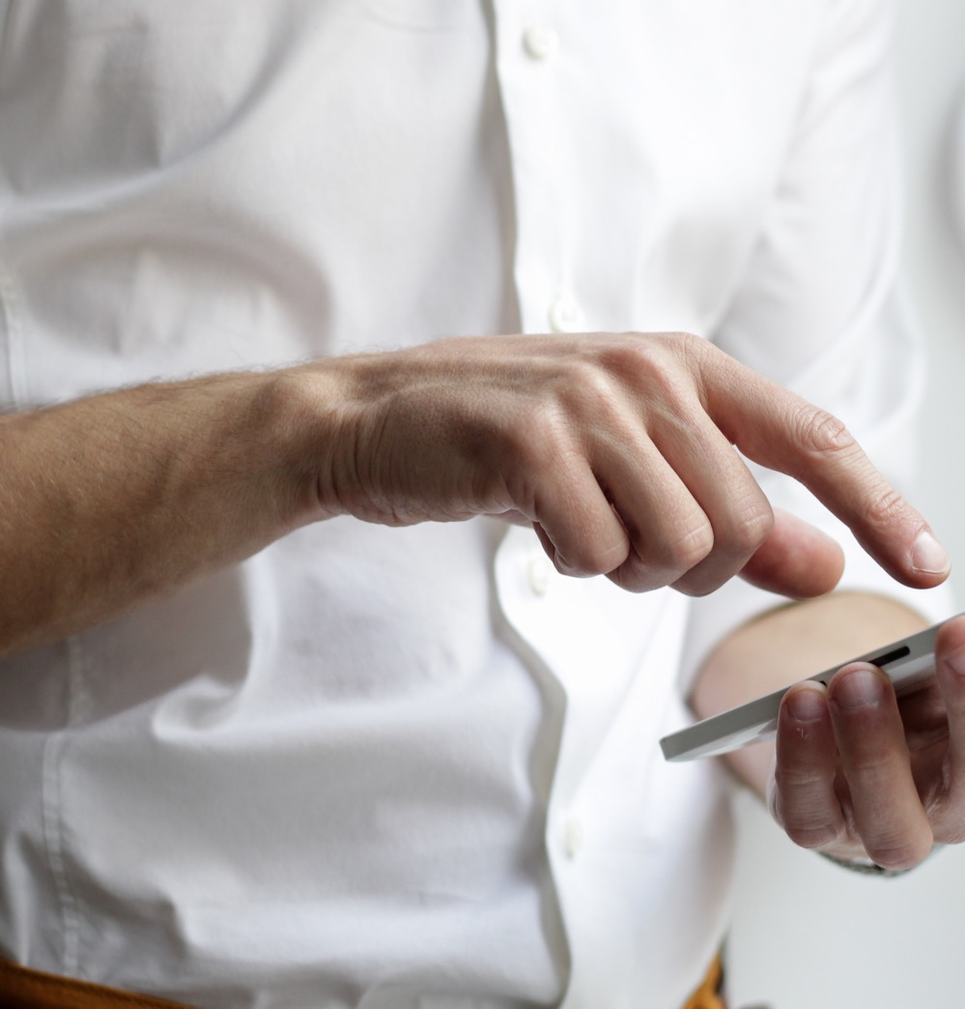



About Us
Why we choose this project?by survey :
Most of the people don’t know how many doctor live near them
Most of them don’t know which doctor is best
Most of them don’t go hospital for laziness
Most of then don’t know the name of specialist
Most of them want to get medicine all the time
Most of the people want 3 in 1 service apps
Revised Requirement Analysis after Collection of Data :
Doctor Finder – Complete Medical Solution android application is combo app to find doctors, Pharmacies & Hospitals near you, you can find doctors within your city, check for pharmacy near you or even find list of hospitals and compare services.The mobile app will be free to sign up.It will be available across all mobile platforms including all Android devices, tablets, laptops, and chrome-books.
Most of people want to contact with doctor anytime sitting in Their own home in this pandemic
We’ll be looking to make an Application for mobile using Android Studio and database.
Construction :
Platform:
Language:
Database:

Slide 3

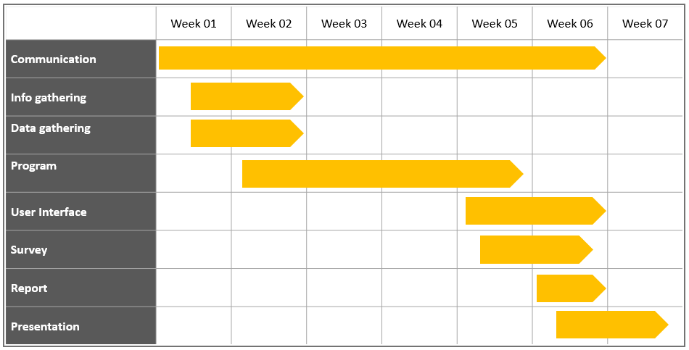
Our Promises:
Features:
Login page:
Register Page:
Doctors:
Hospital:
Pharmacy:
About us page:
Receipt page:
Favourite list :
Social Media:
Setting:
Review:

Slide 4

Operation 1
LOGIN :

Slide 5
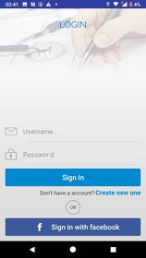
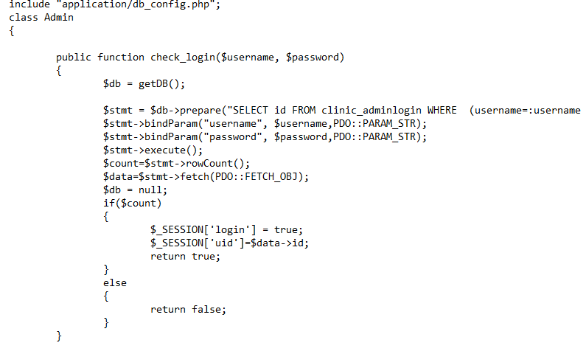
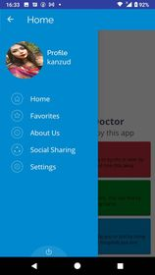
LOGIN

Slide 6

Operation 2
Register Page :

Slide 7
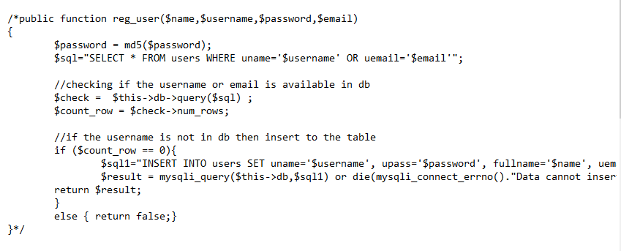
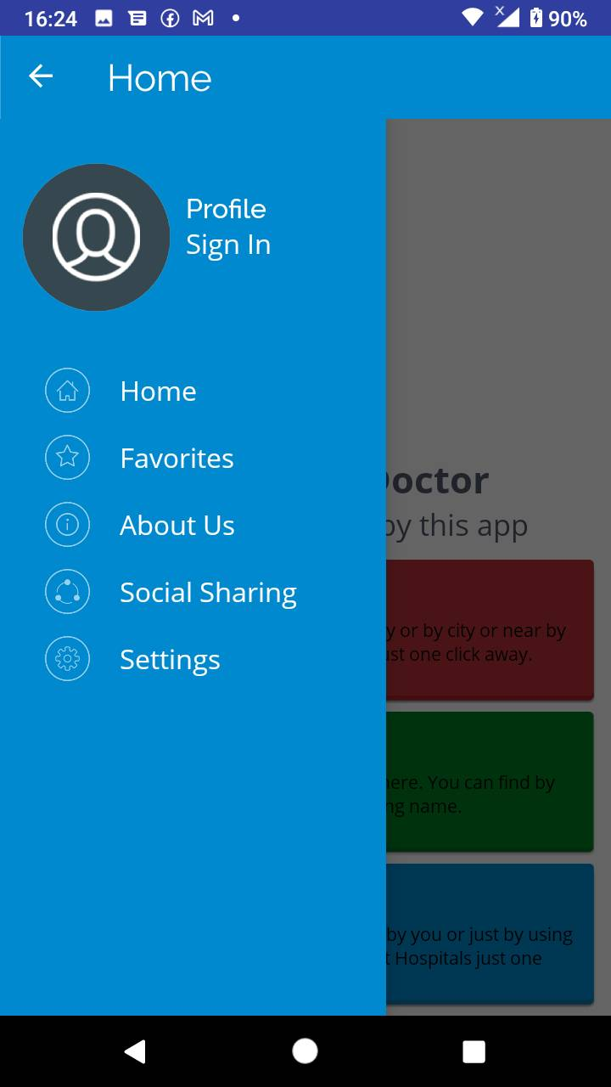
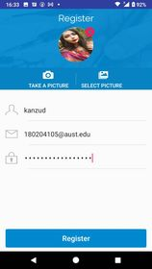
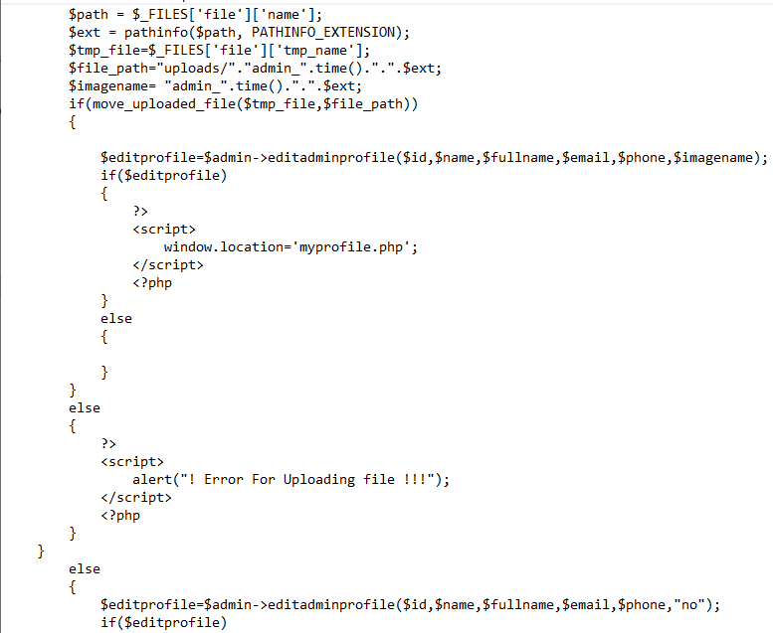
Register page:

Slide 8

Operation 3
Doctors:

Slide 9
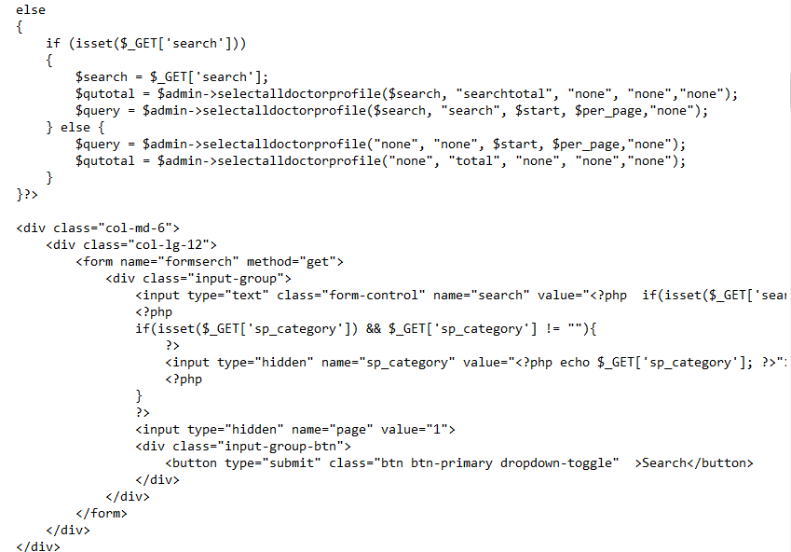
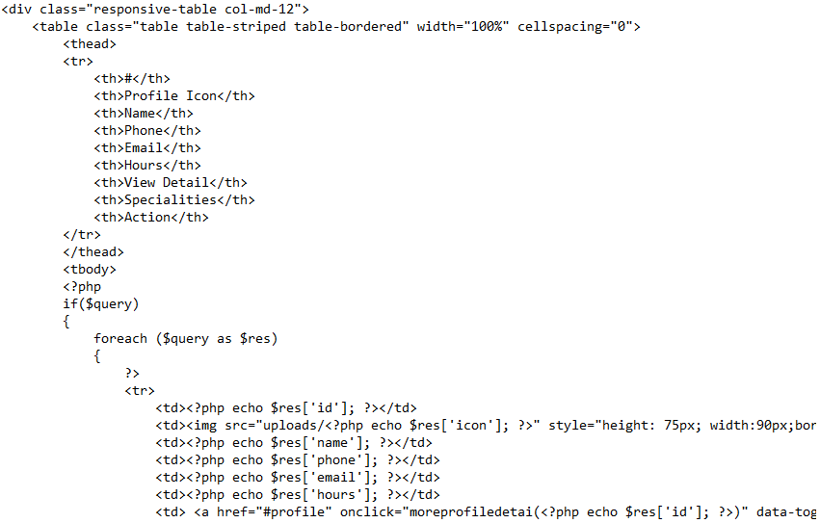
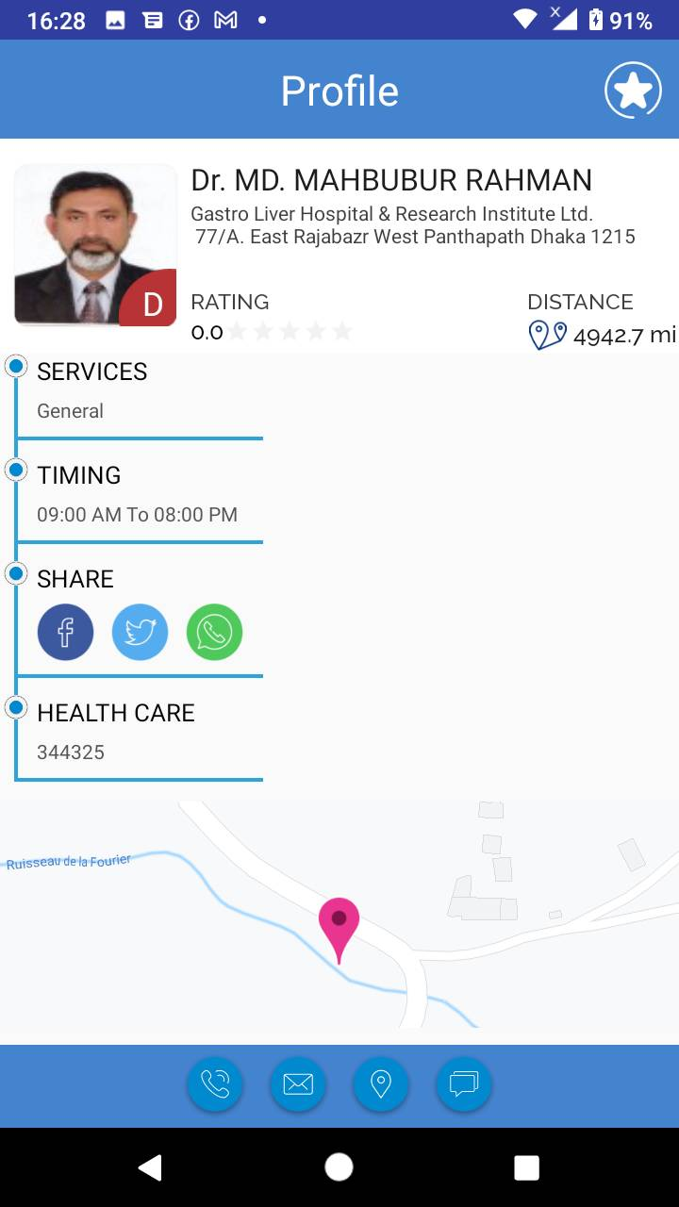
Doctor Page :

Slide 10

Operation 4
Appointment:

Slide 11
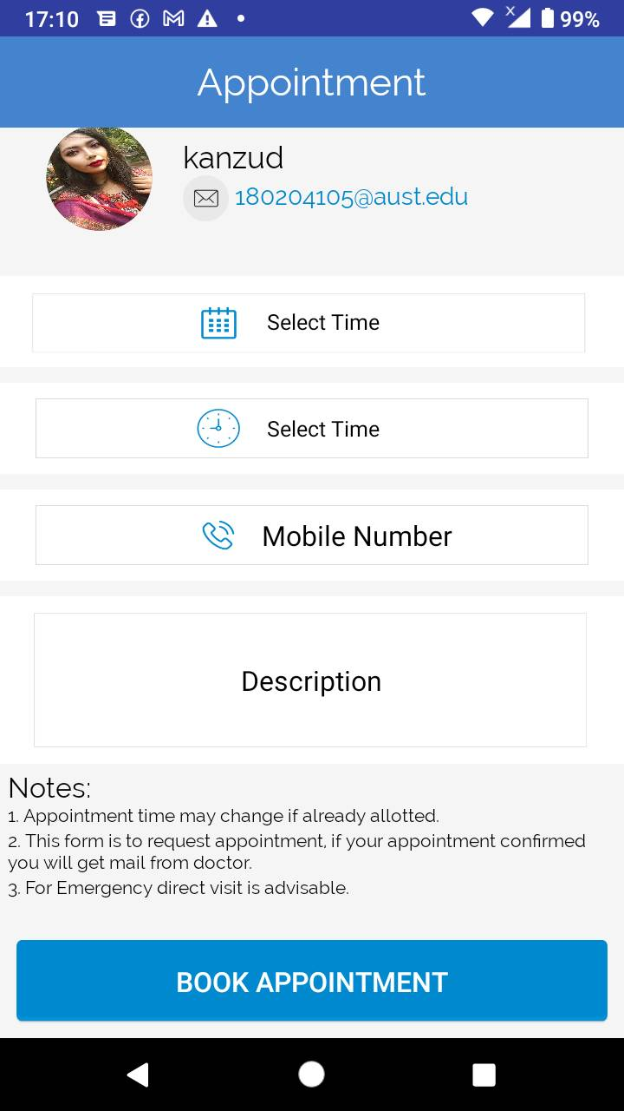
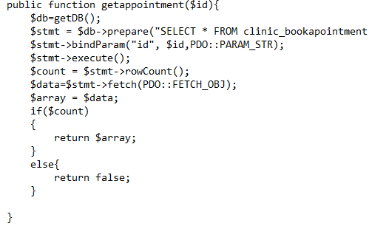
Appointment Page:

Slide 12
Operation 5
Setting:

Slide 13
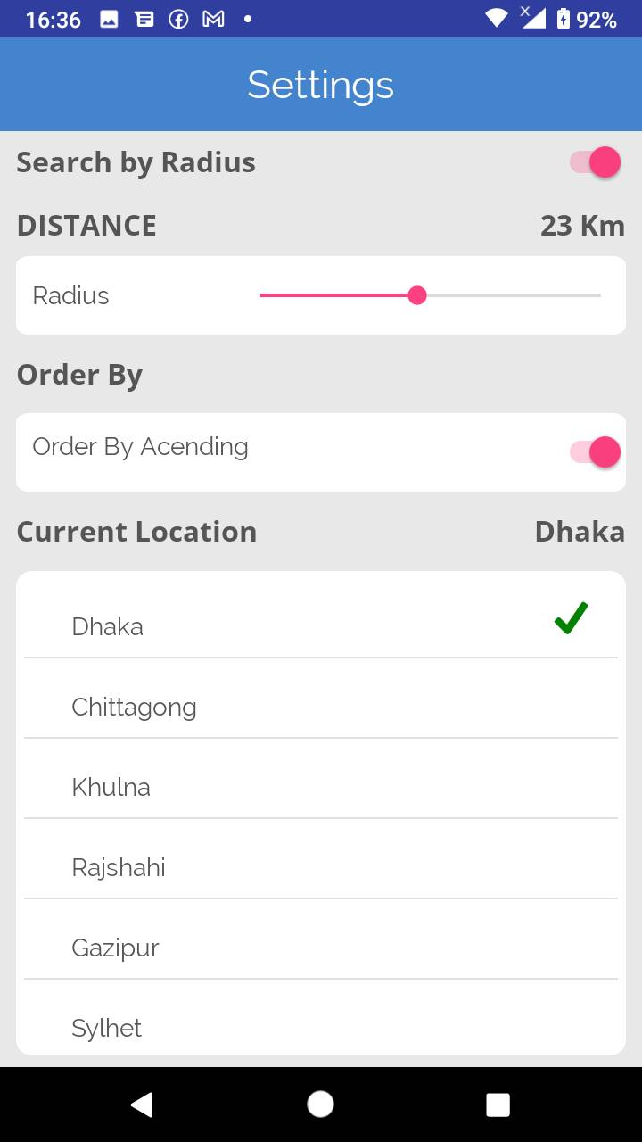
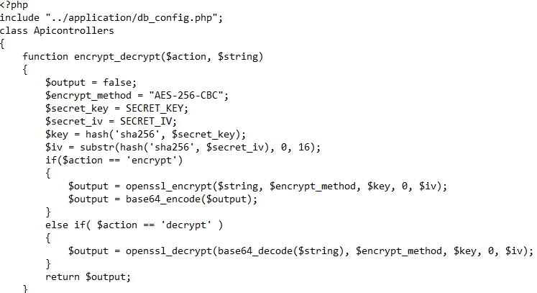
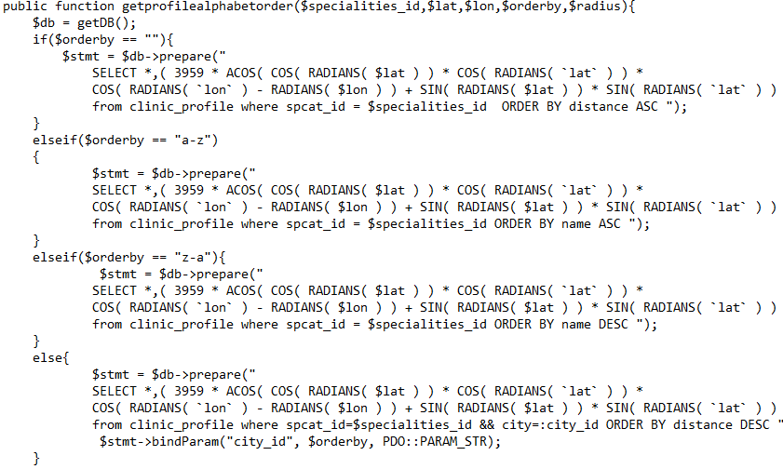
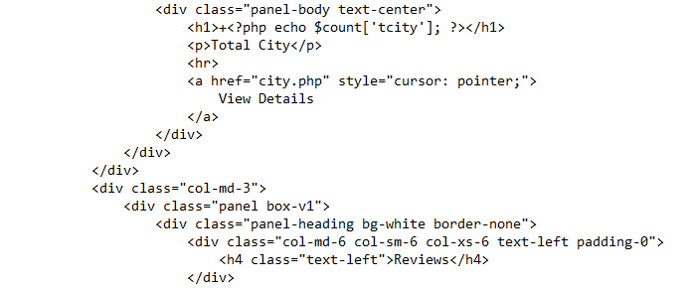
Setting:

Slide 14
Operation 6
RATTING:

Slide 15
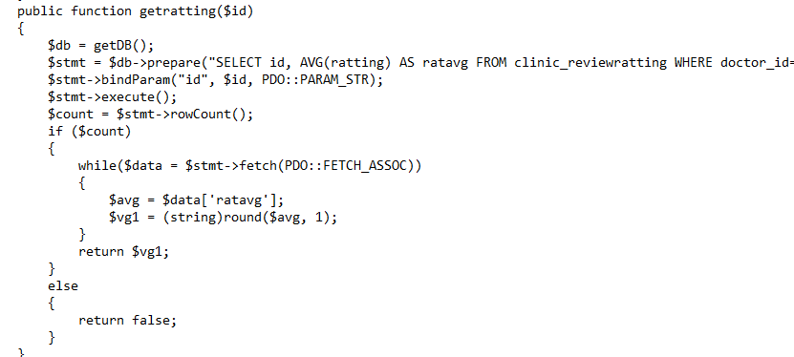
DOCTOR PAGE:

Slide 16
Operation 7
DATABASE:

Slide 17
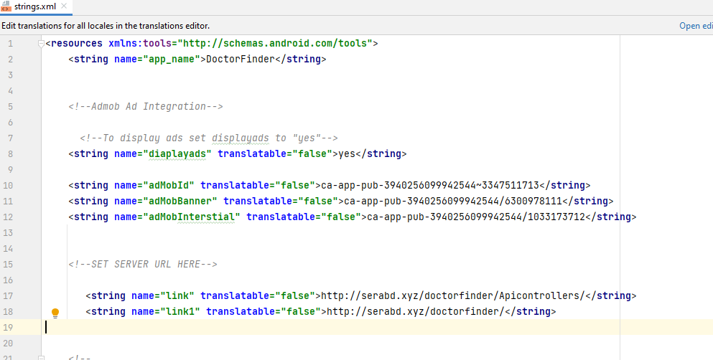
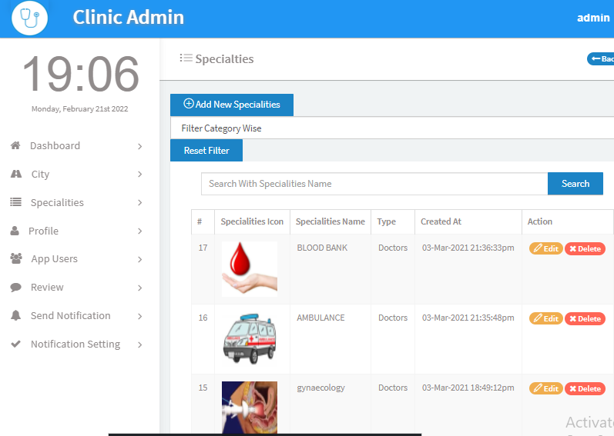
DATABASE:

Slide 18
FUTURE FEATURESS:

Slide 19
Future Features:
Hospital:
Pharmacy:
About us page:
Receipt page:
Favourite list :
Social Media:
Review:

Slide 20

Thank You

Slide 21
Customize this Template
Template Editing Instructions and Feedback

